Slide 1
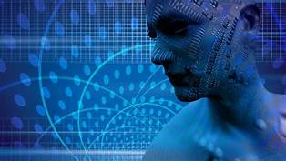
FACIAL EMOTION RECOGNITION
Presented By: Group 21
19ucs129 - Rishabh Sahu
19ucs091-Mansi Agarwal
19ucs193-Hemang Goyal
19ucs024-Hardik Bhati
19ucs028-Abhishek Tiwari

Slide 2
Aim Of The Project
The project aim is to recognise the emotion of a face in given image containing a face using concepts like Image Denoising using Median Filter and Contrast Stretching.We have also used OpenCV library in Python and Matplotlib library.

Slide 3
Implementation Sequence
Image Selection
Image Enhancement
Face Detection
Facial Emotion Recognition

Slide 4
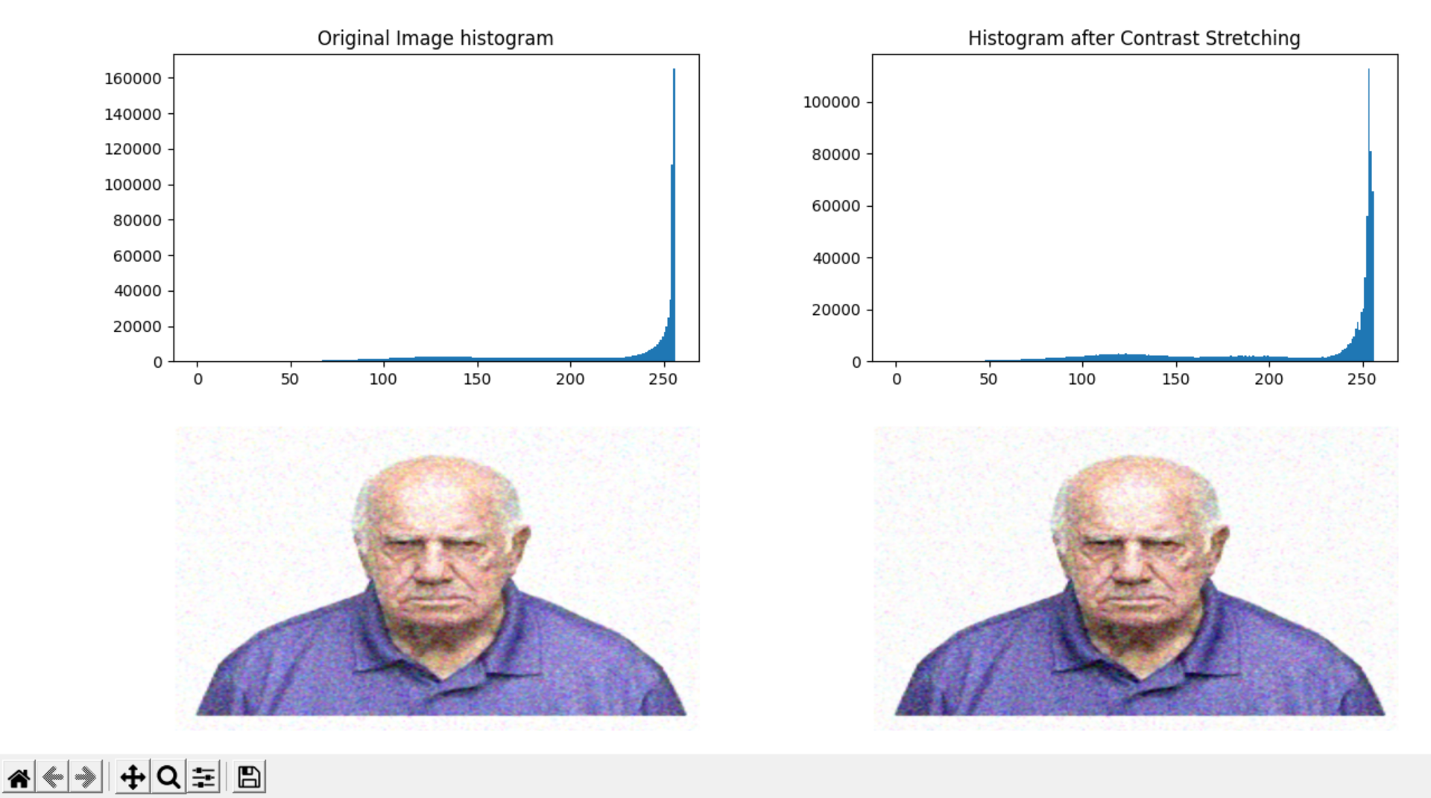
Process of Facial Emotion Recognition
Image Selection: A file picker window is opened from which we can select the image on which we want to run the facial emotion recognition program.
Image Enhancement: We will use the Image Denoising and Contrast Stretching to enhance our images.

Slide 5
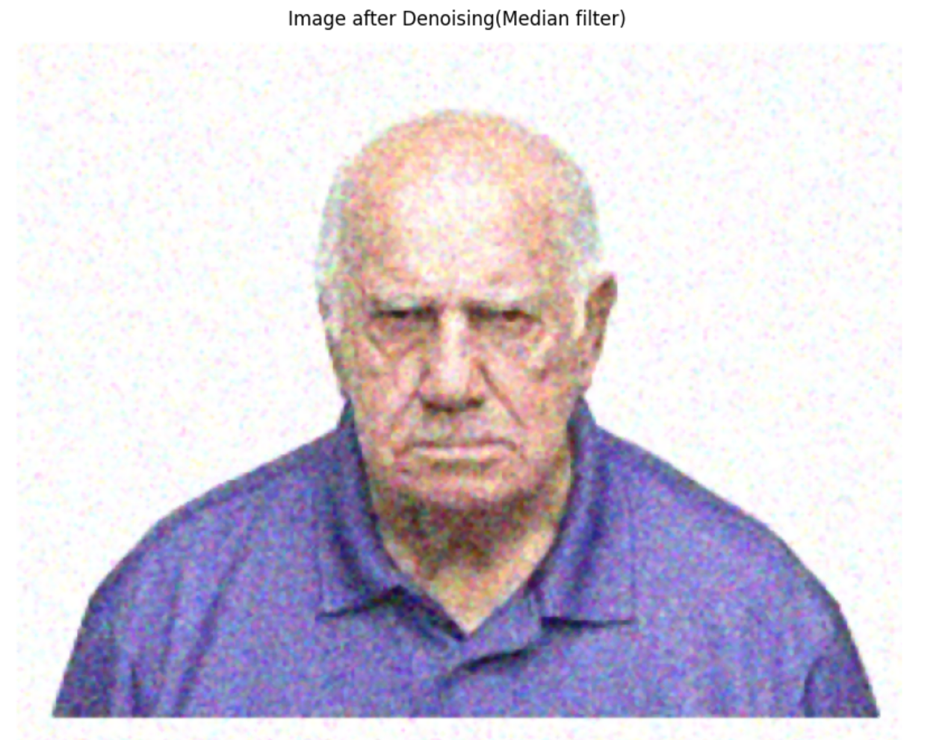
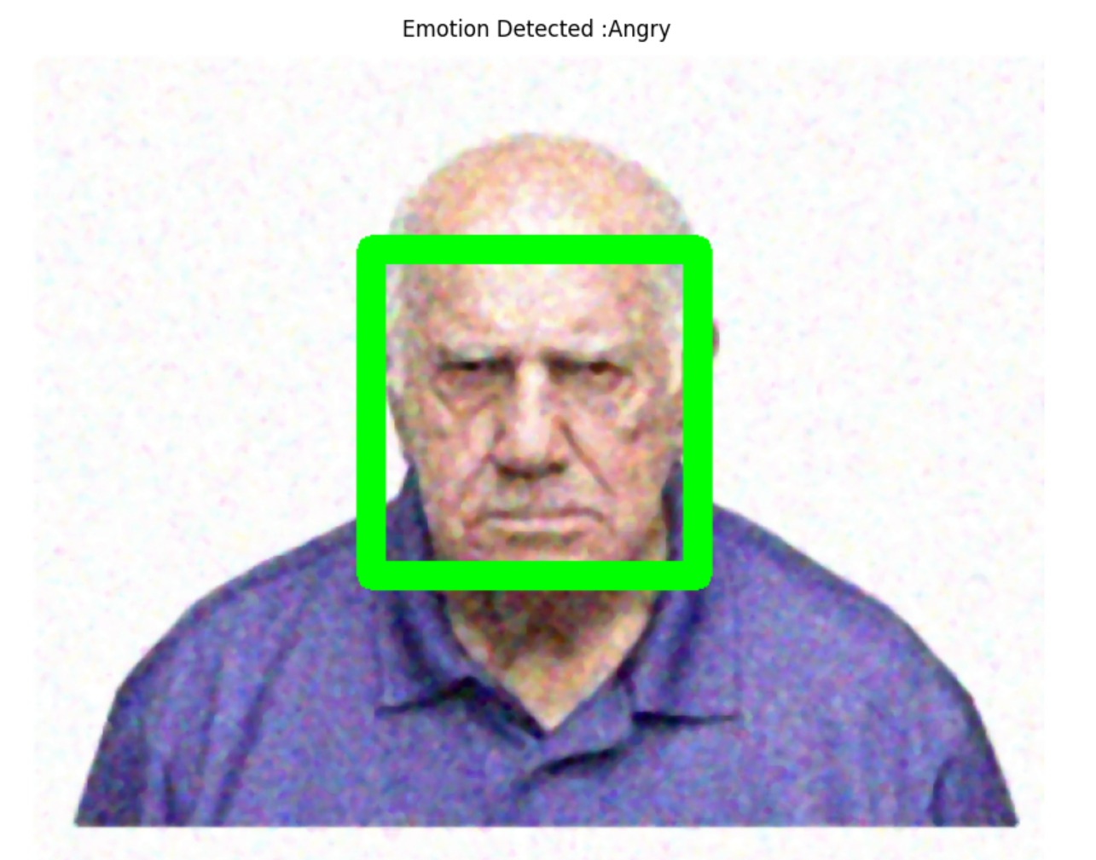
3.Face Detection: We will now detect the face from the
selected image using HAAR Classification model.
4. Face Emotion Recognition: The face emotion is then detected using python keras library and online 6-Layer CNN dataset.
Image after Denoising
RESULTANT IMAGE

Slide 6
Techniques Used
Image Denoising using Median filter: In this method, a median filter is used which is a square matrix of odd order. It eliminates the salt and pepper noise from the image resulting in a smooth output.
Contrast Stretching of an image by manipulation of intensity values: This method attempts to improve an image by stretching the maximum and minimum intensities present to the possible min and max intensity values.
GrayScaling:This method is used to convert the given image from color to gray-scale images as the gray-scale images are more efficient to work with then RGB images.

Slide 7
THANK YOU!

